Slide 1
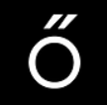
One-Hot Coffee
Team Members: Cassidy Madison, Ethan Semrad, Ching-Lung Hsu
https://github.com/madisonc27/Team-Dragonfly
May 2022 The Erdos Institute
Data Science Bootcamp

Slide 2
Introduction
Rationale: Coffee is one of the world’s most popular beverages. An estimated 75% of the US adult population reported drinking coffee. (Loftfield, Erikka, et al., 2016)
Target Audience: Coffee importers and distributors.
Main Question: Can we find a correlation between coffee taste rating and other features?
Our approaches: We approach this question in two different trials.
Classify the country of origin/altitude/bean processing method.
Predict the overall rating based on other features.
https://www.ncbi.nlm.nih.gov/pmc/articles/PMC4997286/
Notes:
https://www.ncbi.nlm.nih.gov/pmc/articles/PMC4997286/
Loftfield, Erikka, et al. "Coffee drinking is widespread in the United States, but usual intake varies by key demographic and lifestyle factors." The Journal of nutrition 146.9 (2016): 1762-1768.

Slide 3
The First Trial

Slide 4
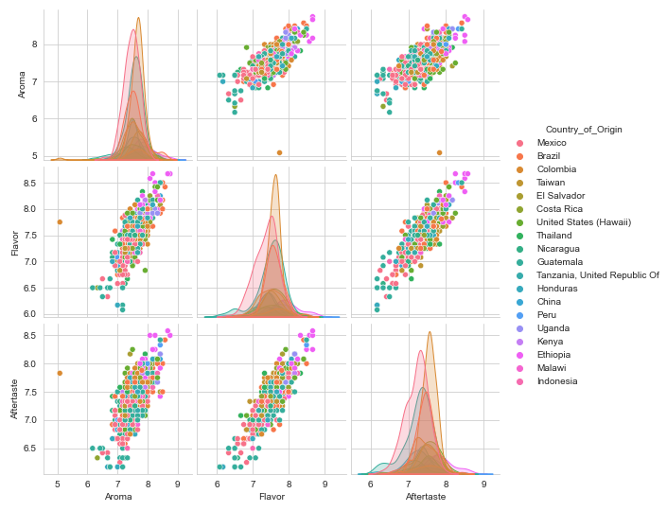
EDA
Selected predictors: Aroma, Flavor, Aftertaste, Acidity, Body, Balance, and Uniformity
Selected feature of interest: Country of origin
Although certain countries appear to have slight separation, most have a high degree of overlap
Notes:
A portion of a pairplot exploring the relationships between variables can be seen on the right

Slide 5
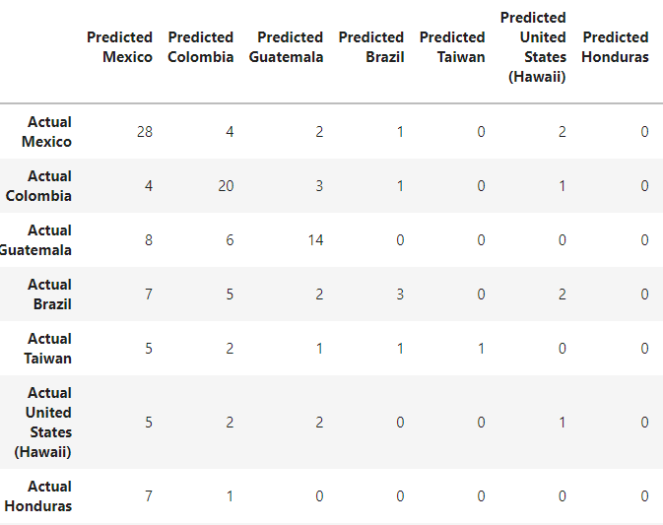
Model Training
Confusion Matrix for SVM
Applied several supervised learning models to the clean data including
1. K-nearest neighbors
2. Decision Tree
3. Random Forest
4. AdaBoost
5. Support Vector Machine
Used accuracy as a base metric to compare the models
Accuracy was around 30 – 35% for each model

Slide 6
Conclusion
Several factors could contribute to the low accuracy:
High correlation between the predictor variables
High degree of overlap between countries
Models tend to place predictions into categories with the largest number of samples
Coffee Quality Institute ratings are not able to distinguish between different countries in these models
Notes:
The data set is supposed to be made to be unbiased for these features.

Slide 7
The Second Trial

Slide 8
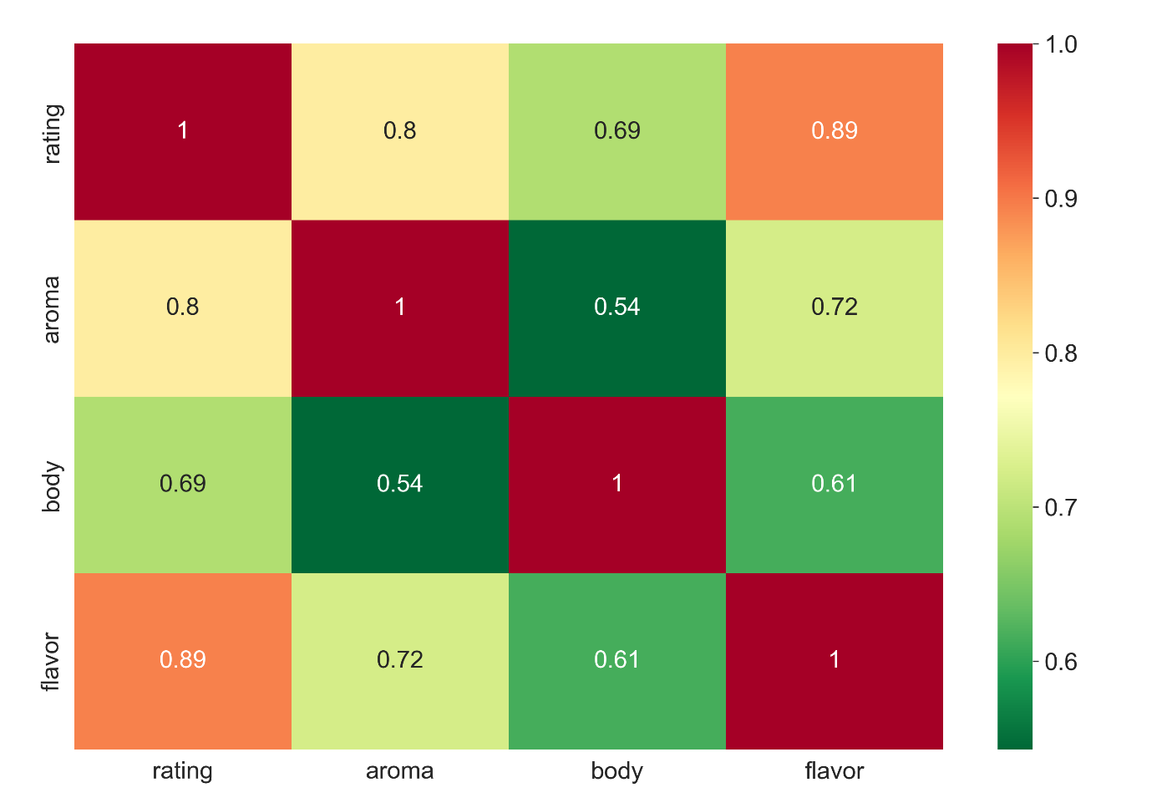
Exploratory Data Analysis
Correlation across
Numerical Features
Numerical features are highly correlated
Chose only categorical predictors
Selected predictors: Region, Roast, Espresso, Organic, Blend, Fair Trade, Decaffeinated, Pod/Capsule, Estate
Selected feature of interest: Rating

Slide 9
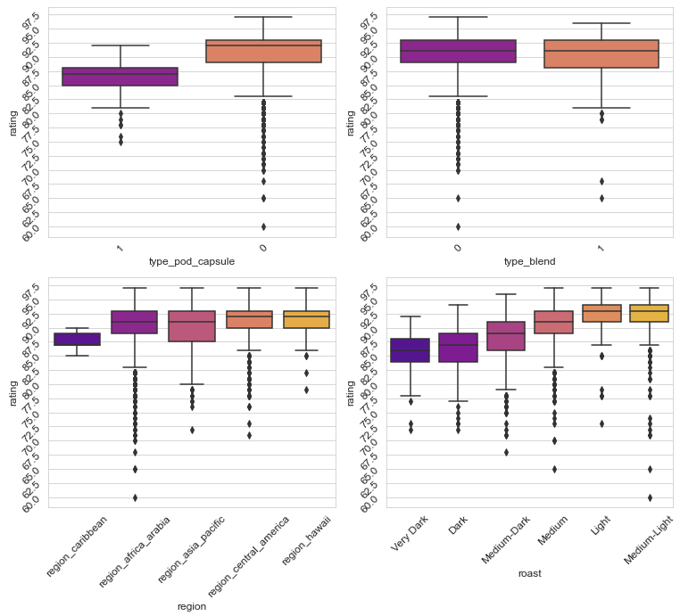
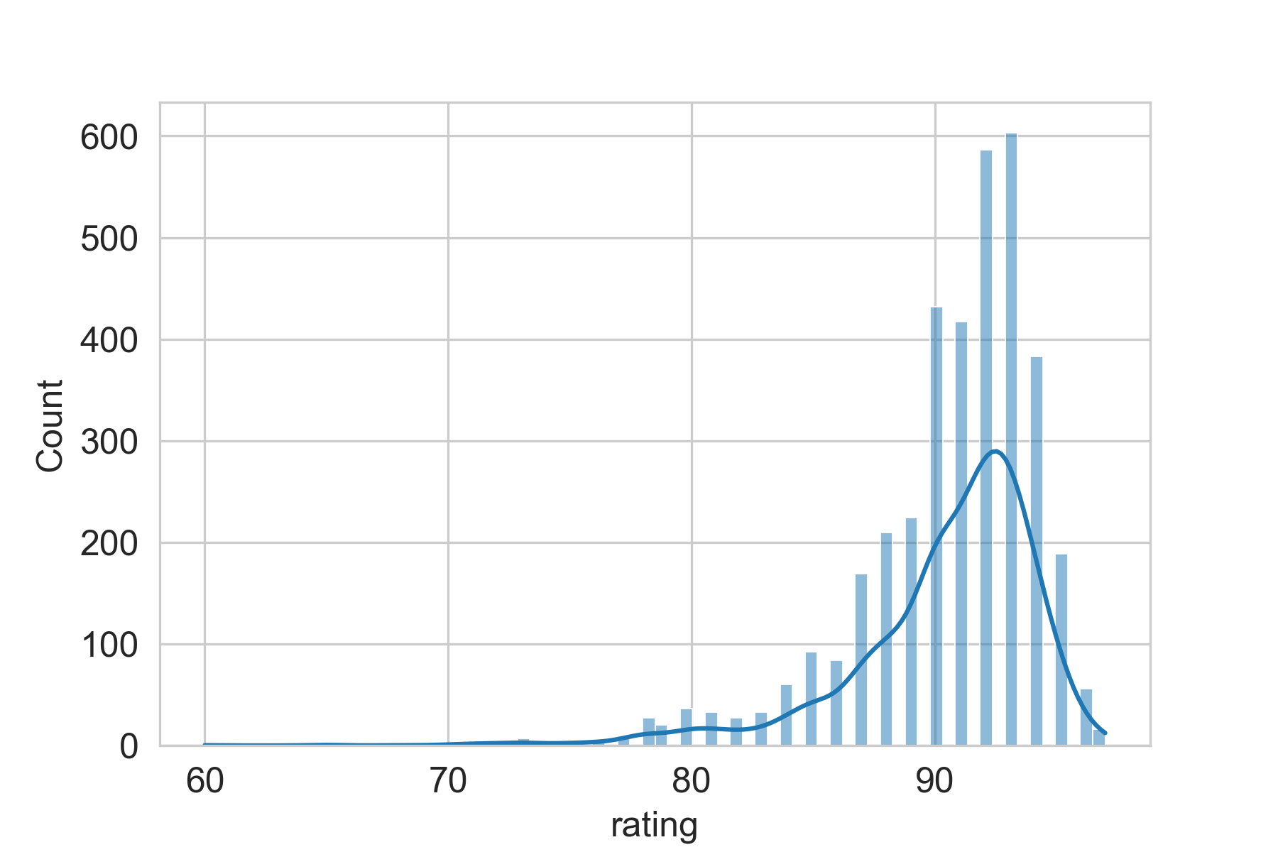
Exploratory Data Analysis
Histogram and Density Plot for Rating
Boxplots for Categorical Features

Slide 10
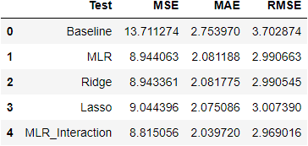
Model Evaluation
Applied multiple linear, lasso, and ridge regression
Used mean rating as baseline prediction
Added interaction terms to multiple linear regression
Evaluated using mean squared error (MSE) and mean absolute error (MAE)
Notes:
We did not apply a polynomial regression because our predictors consist entirely of 0s and 1s.

Slide 11
Conclusion

Slide 12
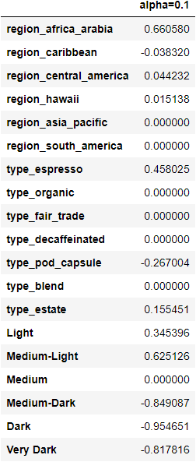
Key Takeaways
Strong positive correlation – features to seek out Africa/Arabia, espresso, estate, light and medium-light roast
Negative correlation – features to avoid pod/capsule, medium-dark, dark, and very dark roast
No correlation – features that have little impact Regions: Asia/Pacific, South America Organic, fair trade, decaffeinated, blend, medium roast

Slide 13
Future Directions
Incorporate price data as a predictor
Utilize natural language processing to extract key words from the professional flavor descriptors

Slide 14
THANK YOU

